Slide 1
.NET Memory Management Fundamentals
Janier Davila
@janierdavila

Slide 2
Objectives
INTRODUCTION
WHAT IS MEMORY?
MANAGED HEAPS (SOH, LOH)
.NET GARBAGE COLLECTOR
BEST PRACTICES

Slide 3
MEMORY MANAGEMENT. WHY BOTHER?
Memory Leaks
Double Frees
Dangling Pointer
Dangling
A
B
FREE
C
Not reachable
Notes:
You can also mention C++ attempts to resolve this problem with share_ptr

Slide 4
QUESTION
What is memory?

Slide 5
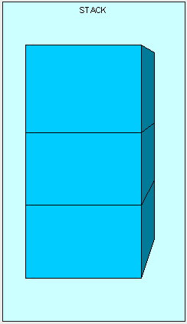
STACK
KEEPS TRACK OF WHAT’S EXECUTING
MEMORY IS SELF-MAINTAINED
EACH THREAD ITS OWN STACK
EACH STACK IS 1MB
STORES VALUE TYPES (CTS)
ALSO STORES OBJ. REF. (ADDRESS)

Slide 6
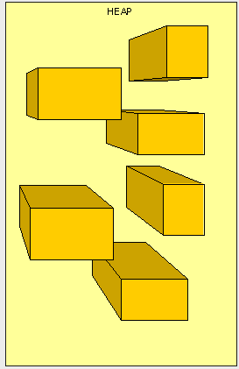
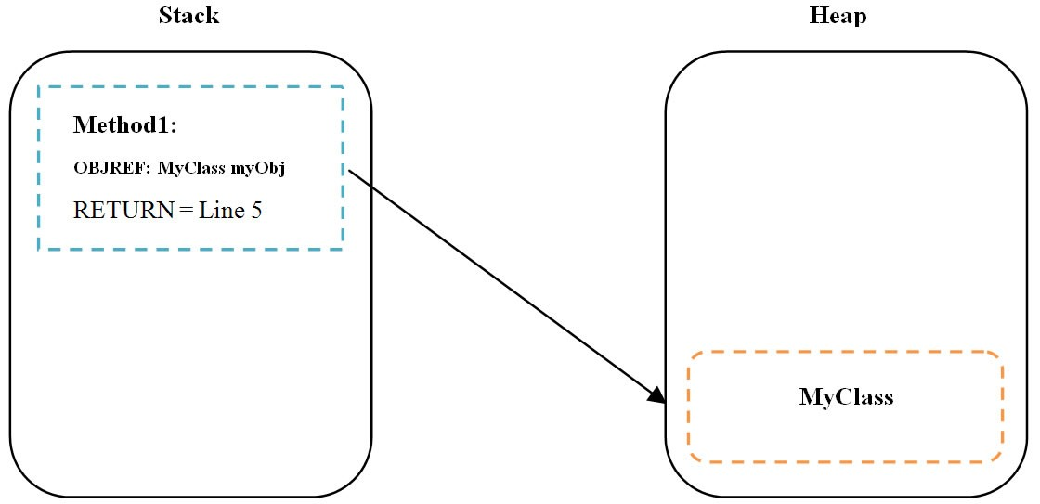
HEAP
ANYTHING CAN BE ACCESS AT ANY TIME
STORES REF. TYPES: CLASSES, INTERFACES, DELEGATES, STRINGS, INSTANCES OF OBJECTS
NEEDS GC FOR MEMORY MANAGEMENT

Slide 7
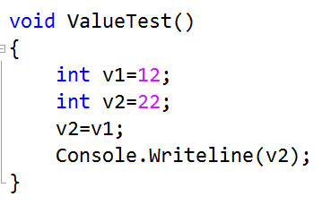
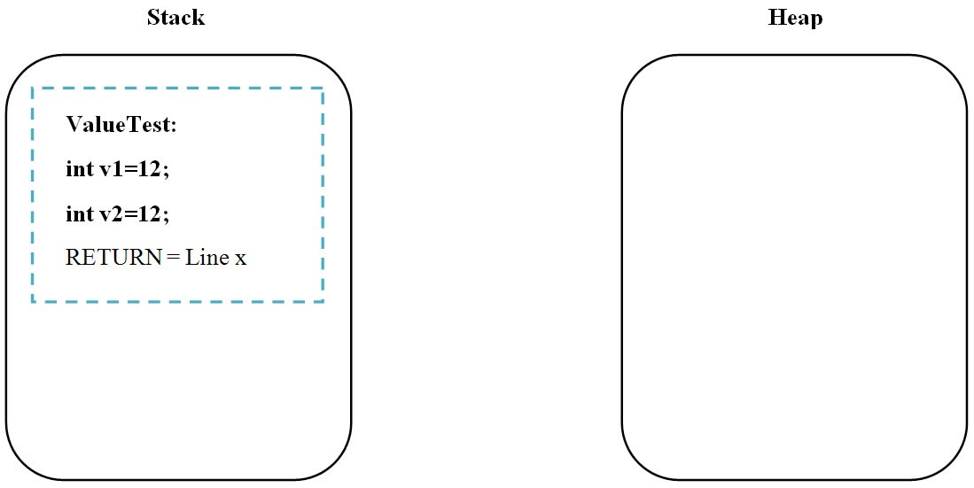
VALUE TYPES

Slide 8
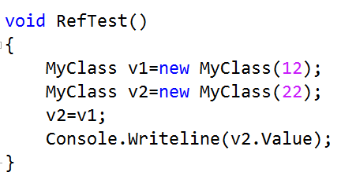
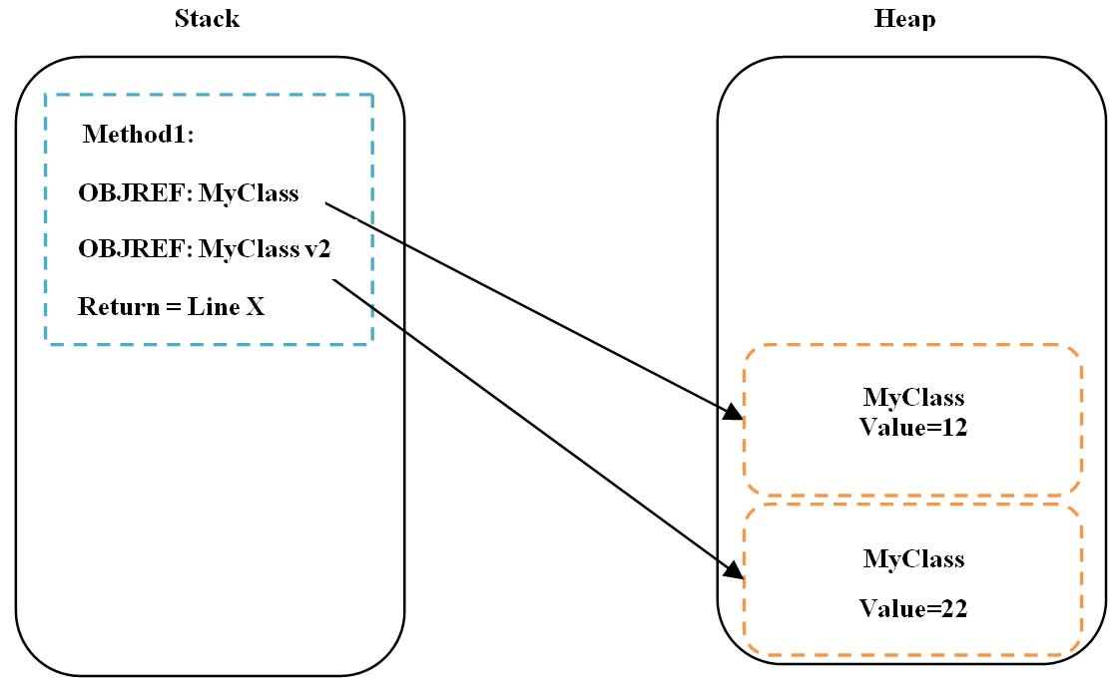
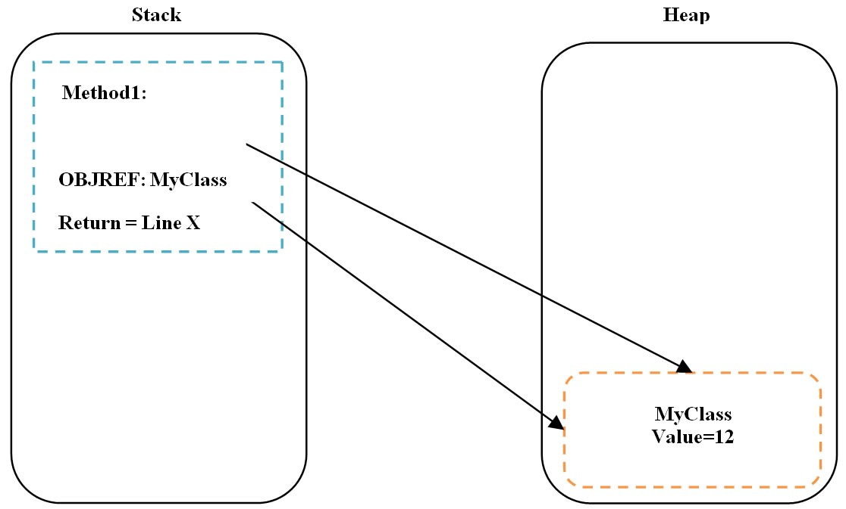
REFERENCE TYPES

Slide 9
GARBAGE COLLECTOR FEATURES
Safety
Throughput
Decent pause time
Good space overhead
Language optimizations
Scalability and portability
Notes:
Safe: Cant reclaim objs that are still referenced
Throughput: Time spent collecting should be as low as possible
Pause: Minimize collector intrusion
Space: Efficient use of space

Slide 10
FOUR APPROACHES
Mark-Sweep collection
Mark-Compact
Reference Counting
Notes:
Reference counting is a form of garbage collection whereby each object has a count of the number of references to it. Garbage is identified by having a reference count of zero. An object's reference count is incremented when a reference to it is created, and decremented when a reference is destroyed. When the count reaches zero, the object's memory is reclaimed.
Mark-Compact After marking the live objects in the heap in the same fashion as the mark-sweep algorithm, the heap will often be fragmented. The goal of mark-compact algorithms is to shift the live objects in memory together so the fragmentation is eliminated.

Slide 11
.NET MANAGED HEAPS
SMALL OBJECT HEAP (SOH) < 85K
LARGE OBJECT HEAP (LOH) > 85K
GC RUNS FOR BOTH DIFFERENTLY

Slide 12
GARBAGE COLLECTOR IN .NET
Generational
Looks for allocated objs not ref by anything
Cleans up both SOH and LOH
Compacts SOH (copy collection)
Server and workstation mode

Slide 13
GC ROOTS
GLOBAL/STATIC REFERENCES
OBJECT FINALIZERS
INTEROP REFERENCES
STACK REFERENCES

Slide 14
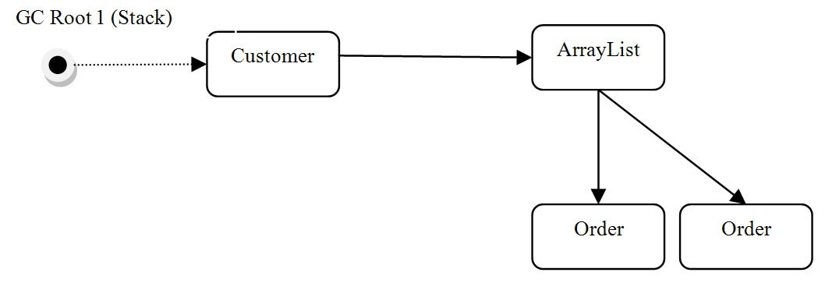
GC ROOTS

Slide 15
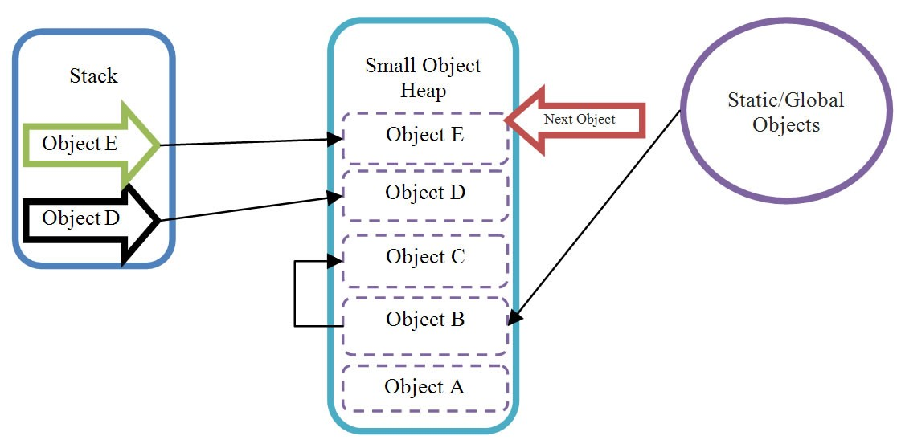
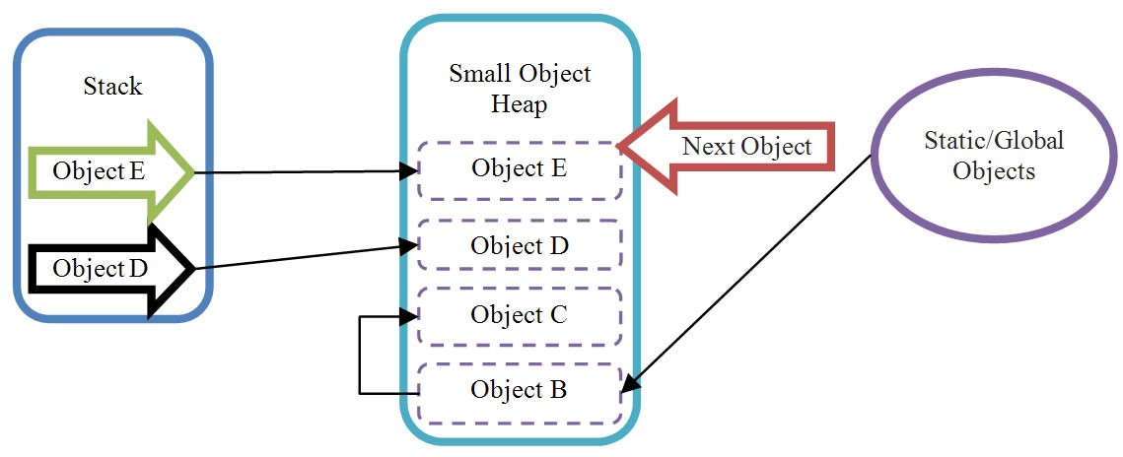
SMALL OBJECT HEAP (SOH)
MOST OBJS CREATED ARE < 85K
HEAVY USED MEMORY AREA
ALLOCATE CONSECUTIVELY
GC COMPACTS ON CLEAN UP

Slide 16
BACK TO .NET GC
.NET GC IS GENERATIONAL
3 GROUPS, GEN 0, GEN 1, GEN 2
GEN 0 ARE MOST COMMON

Slide 17
WHEN GC RUNS
RUNS ON SEPARATE THREAD
GEN 0 HITS ~256 K
GEN 1 HITS ~2 MB
GEN 2 HITS ~10 MB
GC.Collect()
OS SENDS LOW MEMORY NOTIFICATION

Slide 18
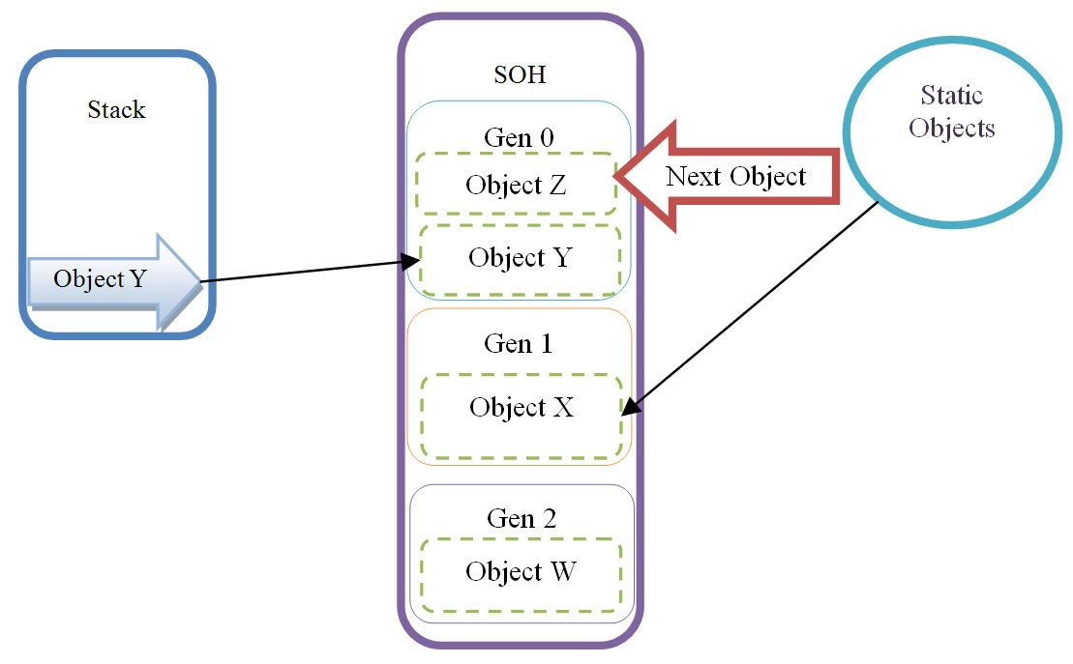
GC GENERATIONS SAMPLE

Slide 19
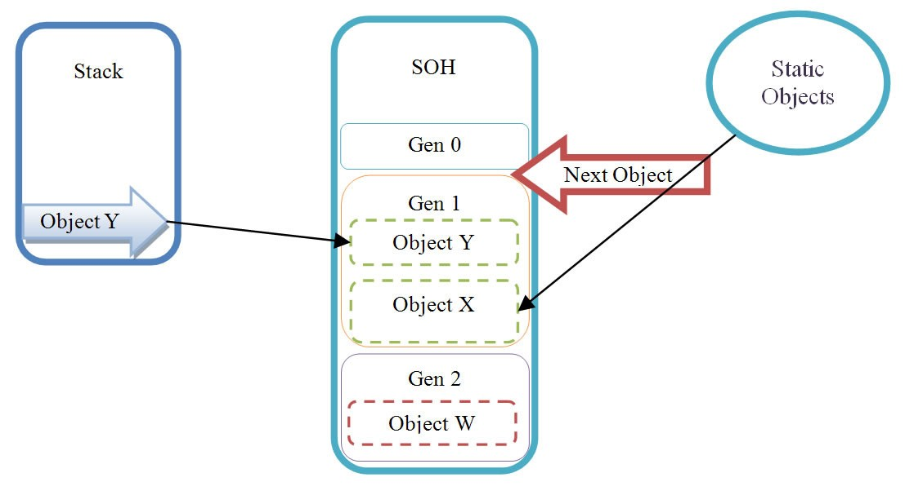
AFTER GEN 0 RUNS
BEFORE
AFTER

Slide 20
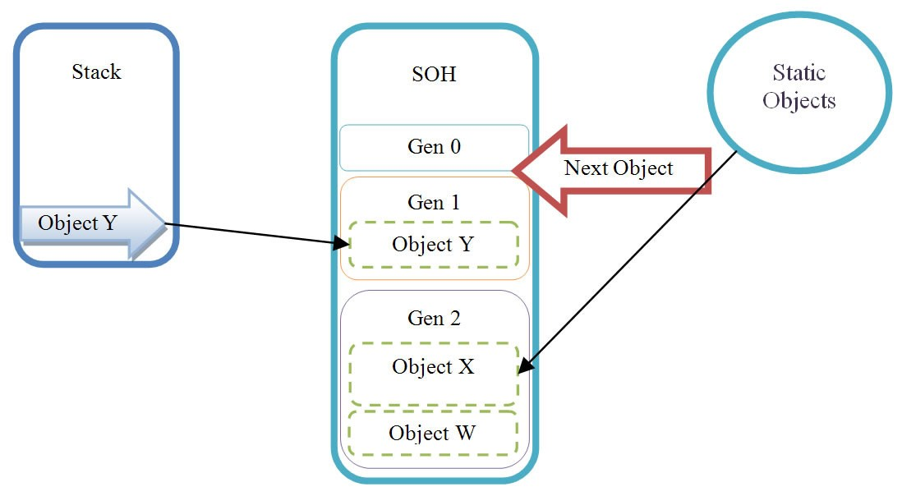
AFTER GEN 1 RUNS
BEFORE
AFTER

Slide 21
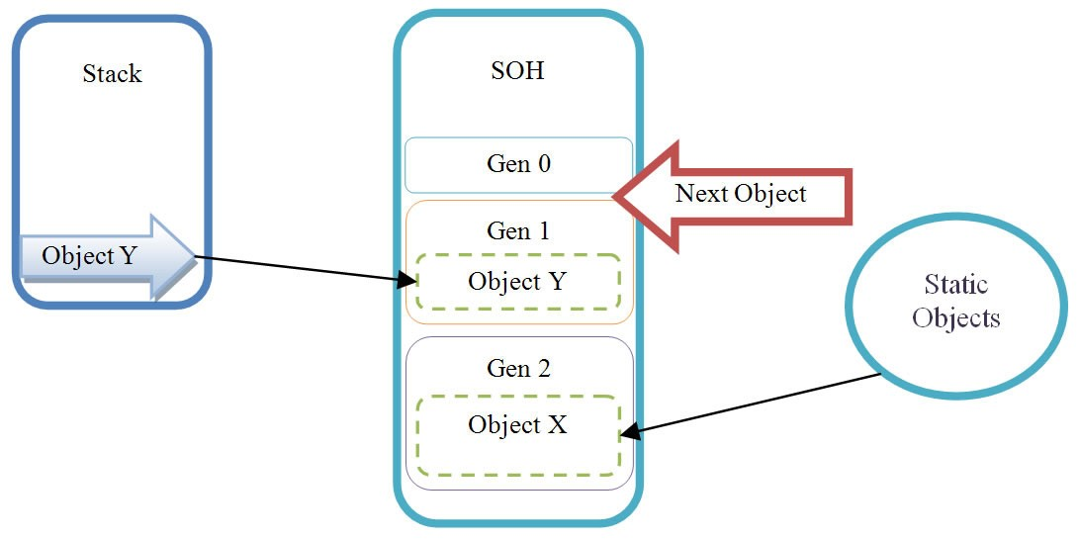
AFTER GEN 2 RUNS (FULL)
BEFORE
AFTER

Slide 22
GC GENERATION GUIDELINES
GEN 0 TEN TIMES MORE THAN GEN 1
GEN 1 TEN TIMES MORE THAN GEN 2
MOST OBJS WILL DIE IN GEN 0
GEN 2 IS EXPENSIVE

Slide 23
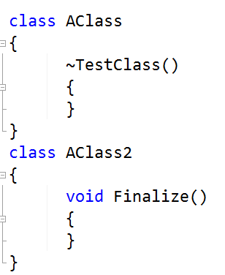
WORD ON FINALIZERS
UNMANAGED RESOURCES NOT CLEANED BY GC
DESTRUCTORS AND FINALIZERS EXTEND THE LIFE OF YOUR OBJ
FINALIZERS GETS CALLED ON ANOTHER THREAD

Slide 24
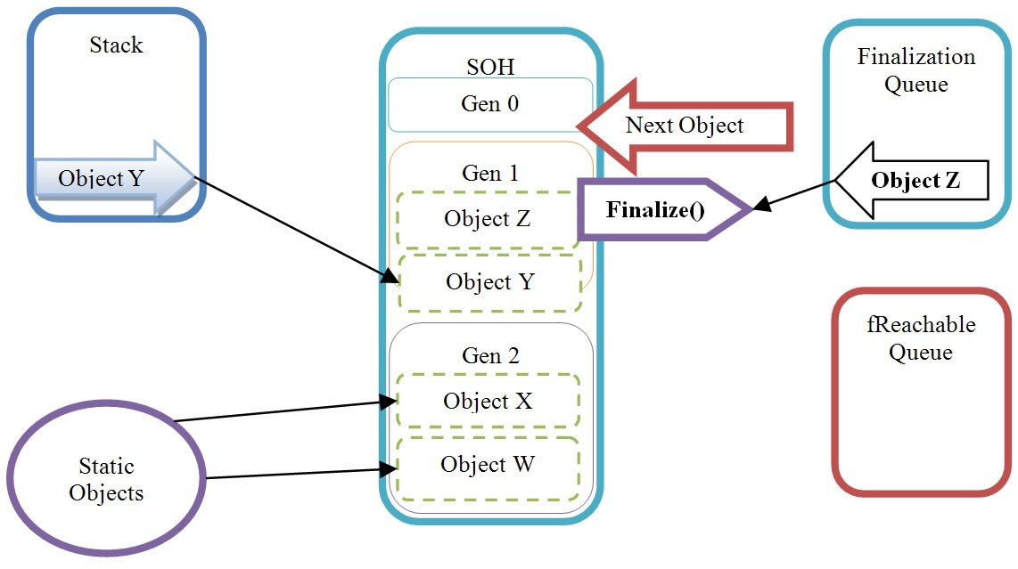
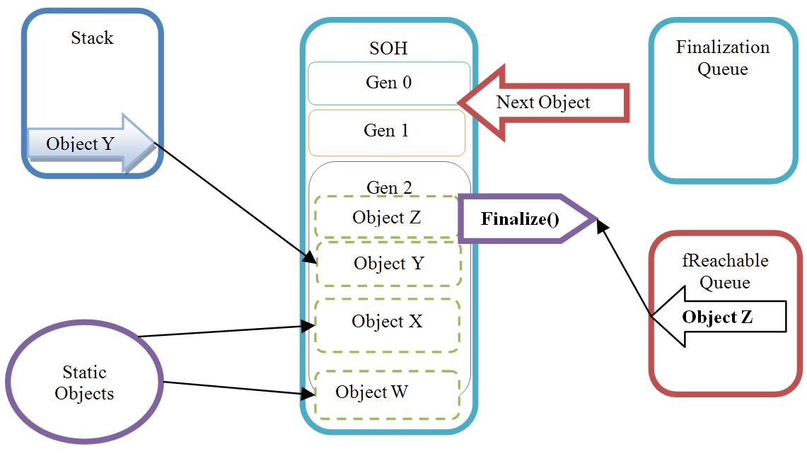
WORD ON FINALIZERS
BEFORE
AFTER

Slide 25
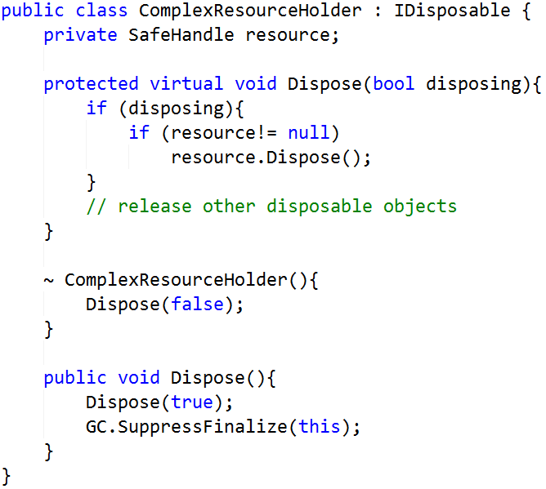
DISPOSE PATTERN

Slide 26
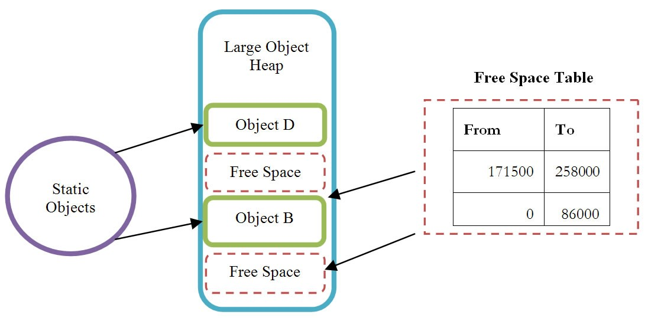
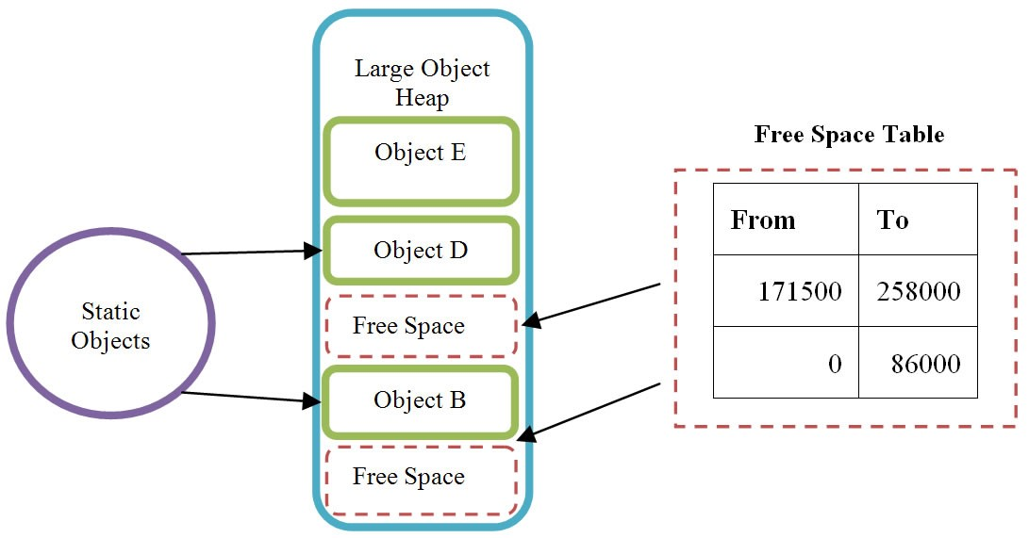
LARGE OBJECT HEAP (LOH)
NOT COMPACTED BY GC, FRAGMENTATION OCCURS
USES FREE SPACE TABLE TO TRACK OBJ ALLOCATION
CLR PREFERS TO ALLOCATE AT THE END
* ARRAY OF DOUBLE > 1000 GOES TO LOH *

Slide 27
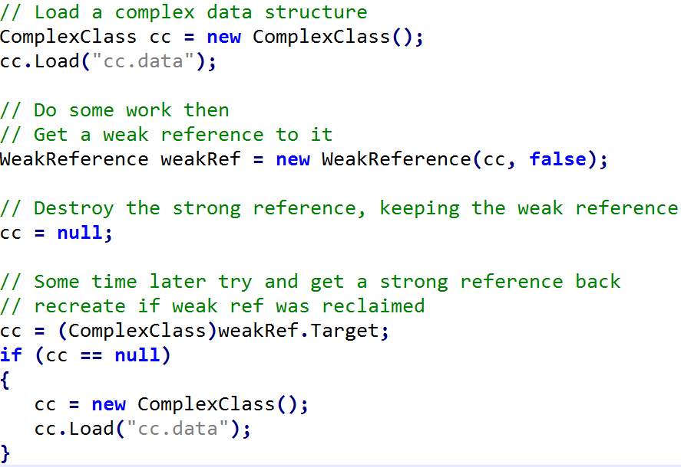
WORD ON WEAK REFERENCES

Slide 28
GC WORKSTATION MODE
MAX RESPONSIVENESS TO THE USER
LIMITS # THREADS SUSPENSIONS
FULL GC RUNS CONCURRENT
SUPPORTS BACKGROUND GC FOR GEN 0 AND 1
BACKGROUND GC SUSPENDS THREADS, BUT GEN 0 AND 1 ARE GENERALLY FAST!

Slide 29
GC SERVER MODE
MAX THROUGHPUT, SCABILITY AND PERFORMANCE
SUPPORTS PARALLEL GC
IT ALLOCATES A SEPARATE SOH AND LOH PER PROCESSOR

Slide 30
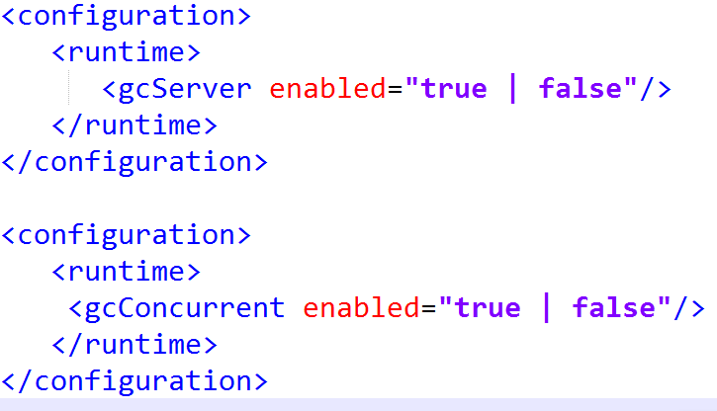
GC CONFIGURATIONS

Slide 31
GC LATENCY CONTROL
GCLatencyMode.Bacth
max performance. UI responsiveness isn’t important
GCLatencyMode.LowLatency
reduces the impact of GC to minimum. Ideal for UI, animations, etc.
GCLatencyMode.Interactive
balance between GC efficiency and app responsiveness.

Slide 32
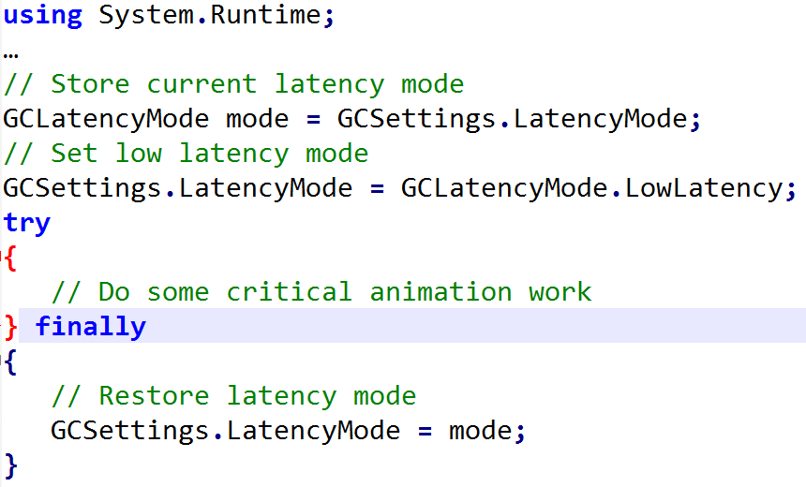
GC LATENCY CONTROL

Slide 33
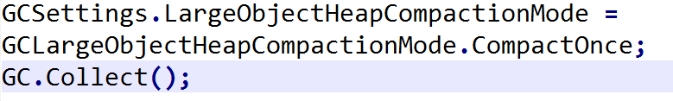
.NET 4.5.1 LOH IMPROVEMENT
GCLargeObjectHeapCompactionMode.Default
LOH is not compacted
GCLargeObjectHeapCompactionMode.CompactOnce
LOH will be compacted during the next blocking gen 2 garbage collection.

Slide 34
BEST PRACTICES
Use the IDisposable interface with the Disposable pattern to release unmanaged resources, and suppress finalization in the Dispose method if no other finalization is required.
Use the using statement to define the scope of a disposable object
Use StringBuilder when the number of string concatenations is unknown or contained within a loop.
Initialize the capacity of a StringBuilder to a reasonable value, if possible.
Initialize collections (such as List<T>) with the target size, if it is known.

Slide 35
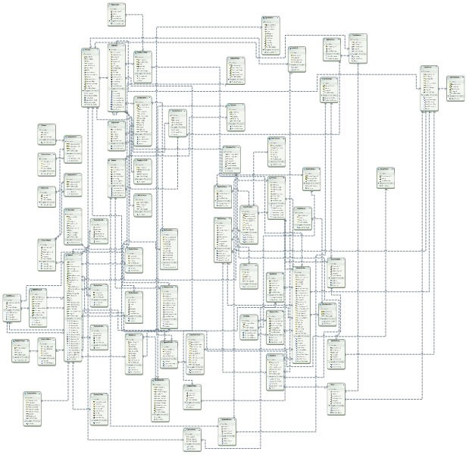
BEST PRACTICES
Avoid maintaining large object graphs in memory.

Slide 36
BEST PRACTICES
In an IIS hosted application, set the //compilation/system.web/compilation/ debug attribute to false before releasing to production.
Remove event handlers before disposing of an object.

Slide 37
REFERENCES
https://github.com/dotnet/coreclr
The Garbage Collection Handbook. The art of Automatic Memory Management.

Slide 38
THANK YOU

